Slide 1
EQUITY RESEARCH
INVESTMENT BANKING

Slide 2



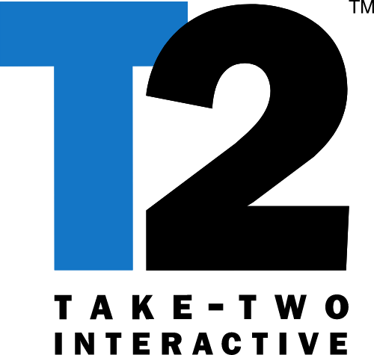




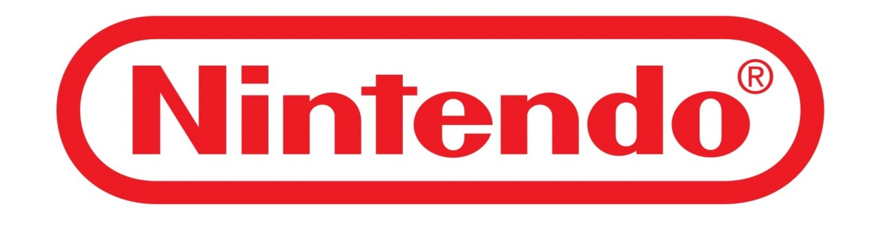



Slide 3
COMPARABLES
1

Slide 4
PRICE
61.19 $
REVENUE
6489
EBITDA
1935
NET INCOME
1503
ENT. VALUE
44810
MARKET CAP
47350

Slide 5
PRICE
73 $
108.9 $
110.7 $
79.59 $
79.65 $
REVENUE
1935.8
1593
2867.4
1870
112.46
EBITDA
773.4
368
588.3
310
38.02
NET INCOME
-43.4
346
334
170
27.5
ENT. VALUE
1077.7
27435.4
10954.9
5320
7592,45
MARKET CAP
9638.2
31545.1
12557.9
6810
7656,22

Slide 6
PRICE
54.85 $
15.13 $
544.98 $
370.16 $
47.35 $
REVENUE
6668.75
2242.65
1326.06
10932.39
2468.26
EBITDA
959.91
934.40
418,87
2664.43
285.31
NET INCOME
593.58
992.89
315.47
2018.02
168.12
ENT. VALUE
9968.57
8990.40
11116.33
44017.08
4487.54
MARKET CAP
12056.69
13318.52
11301.76
44094.72
5645.39

Slide 7
MÚLTIPLOS
2

Slide 8
 | EV/ Revenue LTM | EV/ Revenue 2020 | EV/ Revenue 2021 | EV/ Revenue 2022
Ubisoft | 5.2 x | 6.3 x | 3.6 x | 3.5 x
Electronic Arts | 23.5 x | 7.2 x | 7.0 x | 6.4 x
Take Two Initiative | 5.1 x | 5.1 x | 5.4 x | 4.2 x
Netmarble Games | 2.8 x | 2.5 x | 2.3 x | N/A
Square Enix Co | 2.2 x | 2.2 x | 1.9 x | 1.9 x
Nintendo | 4.0 x | 3.8 x | 3.5 x | 3.6 x
CD Projekt | 61.8 x | 8.7 x | 12.2 x | N/A
Bandai Namco | NM | NM | NM | NM
Nexon | 1.5 x | NM | NM | N/A
Ncsoft Corp | 9.0 x | NM | NM | N/A
Activision Blizzard | 6.9 x | N/A | N/A | N/A

Slide 9
 | EV/ EBITDA LTM | EV/ EBITDA 2020 | EV/ EBITDA 2021 | EV/ EBITDA 2022
Ubisoft | 13.0 x | 13.7 x | 7.3 x | 6.4 x
Electronic Arts | NM | 21.0 x | 20.4 x | 17.9 x
Take Two Initiative | NM | 21.0 x | 20.4 x | 17.9 x
Netmarble Games | 19.3 x | 14.5 x | 13.1 x | N/A
Square Enix Co | 15.3 x | 13.9 x | 11.4 x | 11.0 x
Nintendo | 16.6 x | 14.9 x | 12.4 x | 12.4 x
CD Projekt | NM | 11.0 x | 16.8 x | N/A
Bandai Namco | NM | NM | NM | NM
Nexon | 3.8 x | N/A | NM | NM
Ncsoft Corp | 28.6 x | NM | NM | N/A
Activision Blizzard | 23.2 x | N/A | N/A | N/A

Slide 10
 | P/E LTM | P/E 2020 | P/E 2021 | P/E 2022
Ubisoft | NM | NM | 20.8 x | 19.4 x
Electronic Arts | 91.2 x | 22.8 x | 21.8 x | 19.2 x
Take Two Initiative | 91.2 x | 22.8 x | 21.8 x | 19.2 x
Netmarble Games | 39.7 x | 29.3 x | 26.3 x | N/A
Square Enix Co | 21.6 x | 25.0 x | 18.6 x | 17.6 x
Nintendo | 21.9 x | 21.2 x | 17.1 x | 16.5 x
CD Projekt | NM | 15.5 x | 21.6 x | N/A
Bandai Namco | NM | NM | NM | NM
Nexon | 3.2 x | NM | NM | N/A
Ncsoft Corp | 35.8 x | NM | NM | N/A
Activision Blizzard | 31.5 x | N/A | N/A | N/A

Slide 11
 | Capit / Revenue LTM
Ubisoft | 4,98
Electronic Arts | 19,80
Take Two Initiative | 4,38
Netmarble Games | 3,64
Square Enix Co | 2,20
Nintendo | 3,95
CD Projekt | 68,07
Bandai Namco | 1,8
Nexon | 1,41
Ncsoft Corp | 8,52
Activision Blizzard | 7,29

Slide 12
FOOTBALL FIELD
3

Slide 13
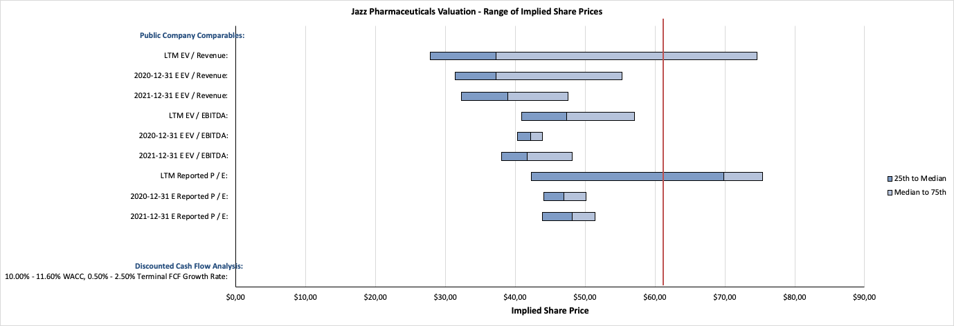

Slide 14
THE END

